Slide 1
Autonomous Chess Board
CM 1900
Intelligent Machines Inspirational Project
Group No 10
University of Moratuwa
Artificial Intelligence Batch 21

Slide 2
Introduction
Our autonomous chess board brings this classic game to life by using modern technology to make the moves for you.
Designed with entertainment in mind, our autonomous chess board is perfect for exhibitions, fairs, and carnivals.
Whether you're a beginner or a casual player looking for a unique and interactive game, our autonomous chess board has something exciting to offer.
Imagine the thrill of watching the chess pieces move on their own, making strategic decisions right before your eyes.
Our autonomous chess board promises a fun and accessible way to enjoy chess like never before.

Slide 3
Group Members
Leader | 215565L | Weerasinghe RT
Member 01 | 215527A | Harischandra HBR
Member 02 | 215538H | Naranpanawa HMSDK
Member 03 | 215559X | Shamil MRM

Slide 4
Problem in Brief
When we engaging in chess physically, there must be another player to accompany us.
In the absence of one player, we use online platforms to play chess.
Playing chess on electronic devices can be frustrating and lead to excessive screen time.
It may cause boredom, restlessness, eye strains, headaches, and discomfort.
Playing chess on a physical chess board can offer improved spatial awareness, and a more enjoyable experience.

Slide 5
Aim and Objectives
Aim
To develop and implement an autonomous chess board for casual players, providing an entertaining and interactive experience at events such as exhibitions, fairs, and carnivals.
Objectives
Auto move computer side pieces according to the chess algorithm
Identify user movements
Display a chess clock
Give a menu to interact with the system

Slide 6
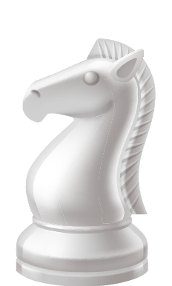
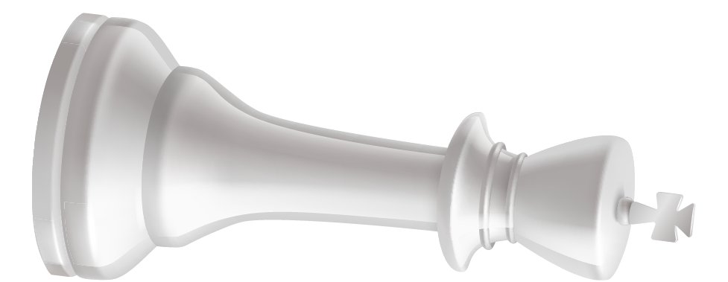
Proposed
Solution

Slide 7
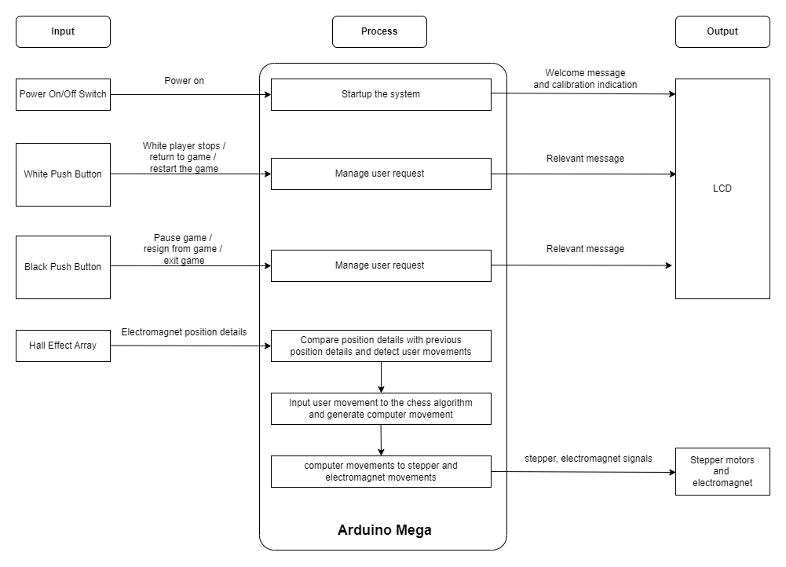
Block Diagram

Slide 8
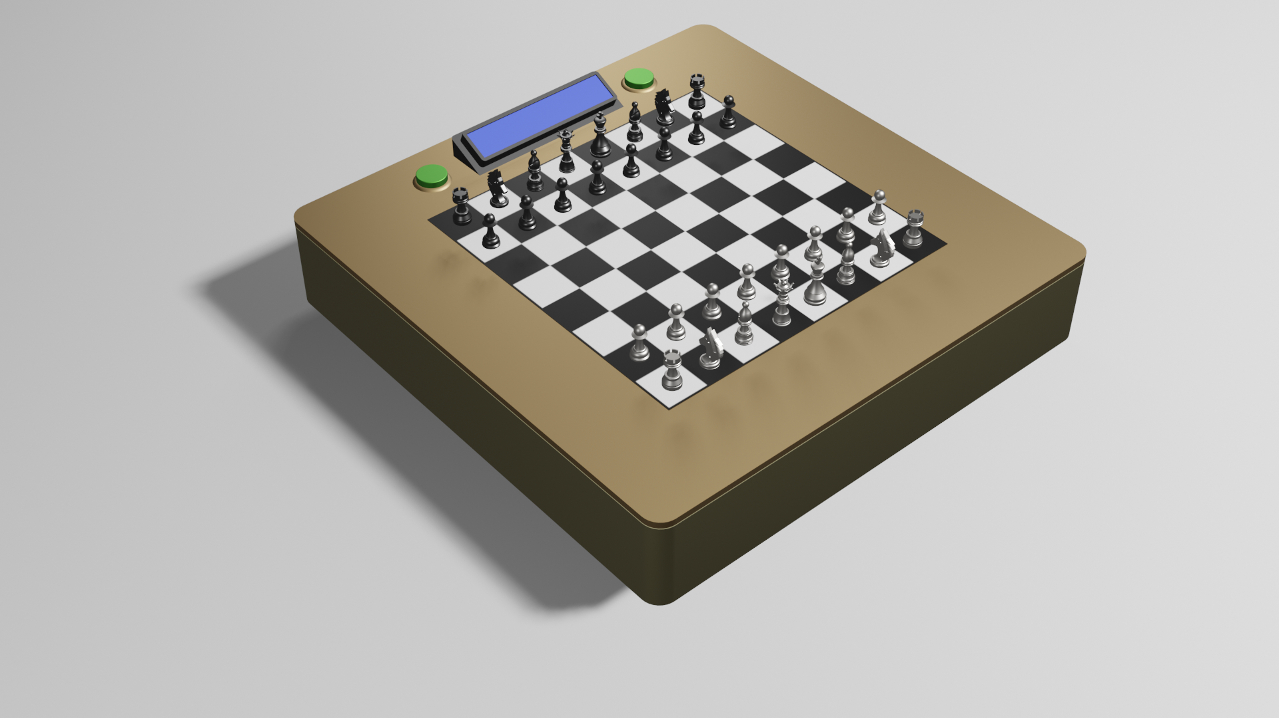
3D model - outer view

Slide 9
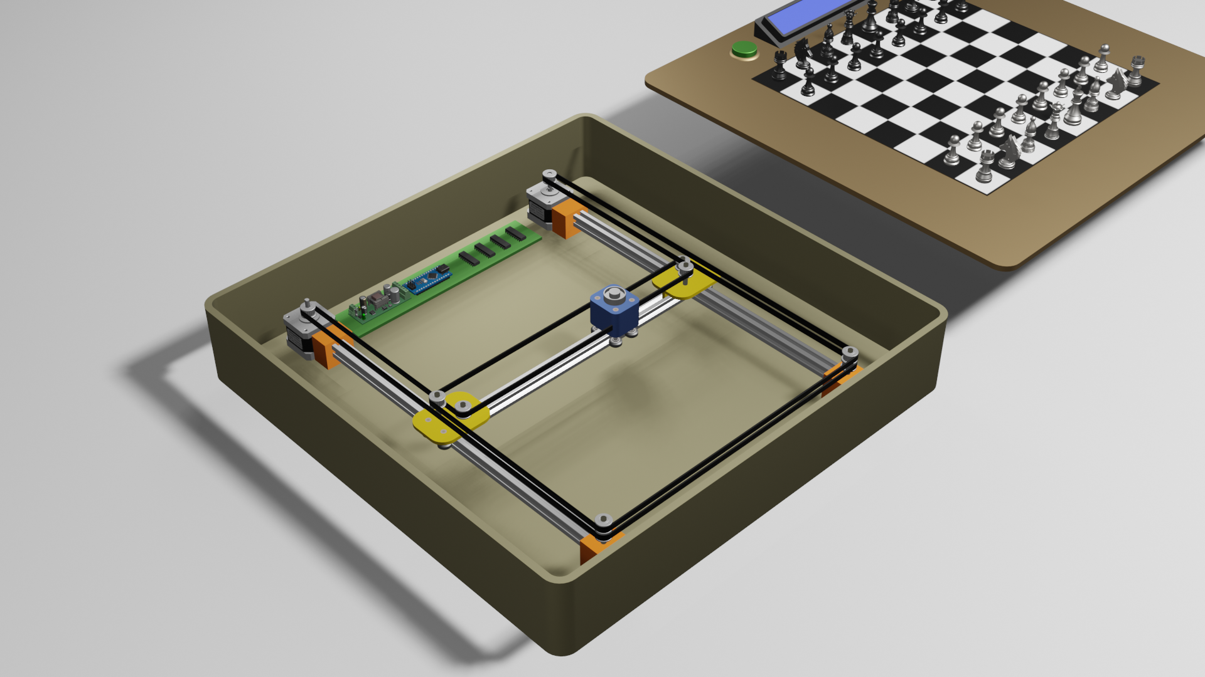
3D model - Inner view

Slide 10
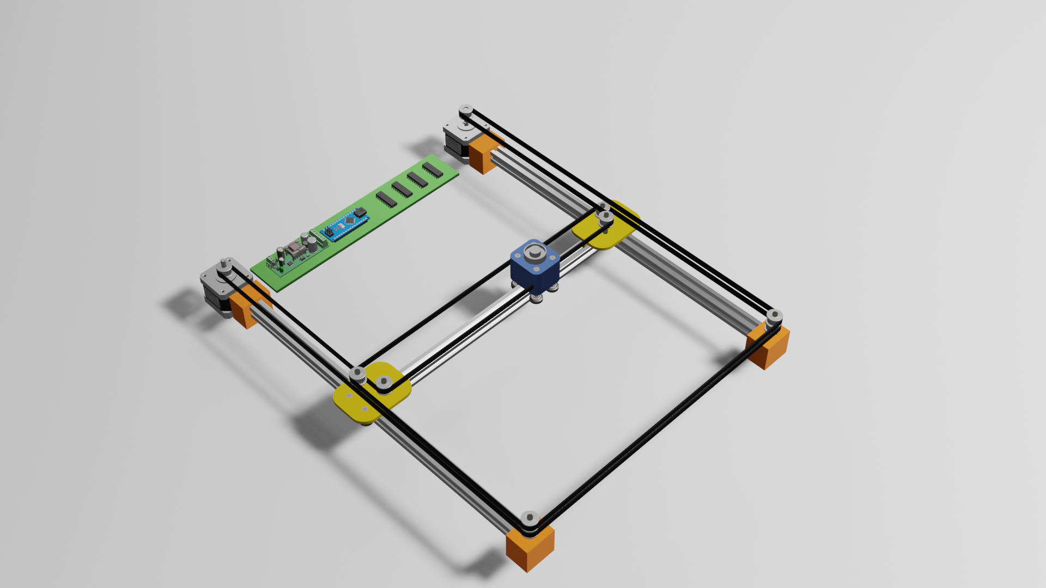
3D model - Railings

Slide 11
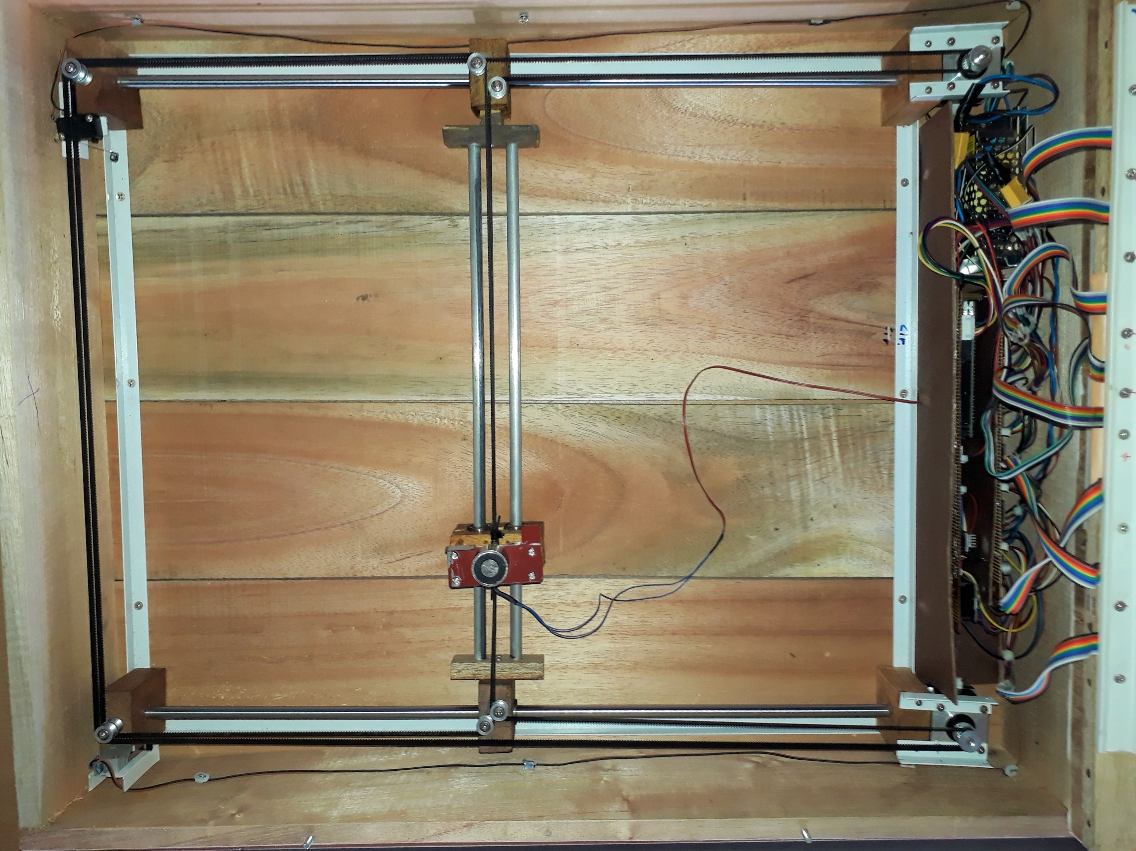
Internals

Slide 12
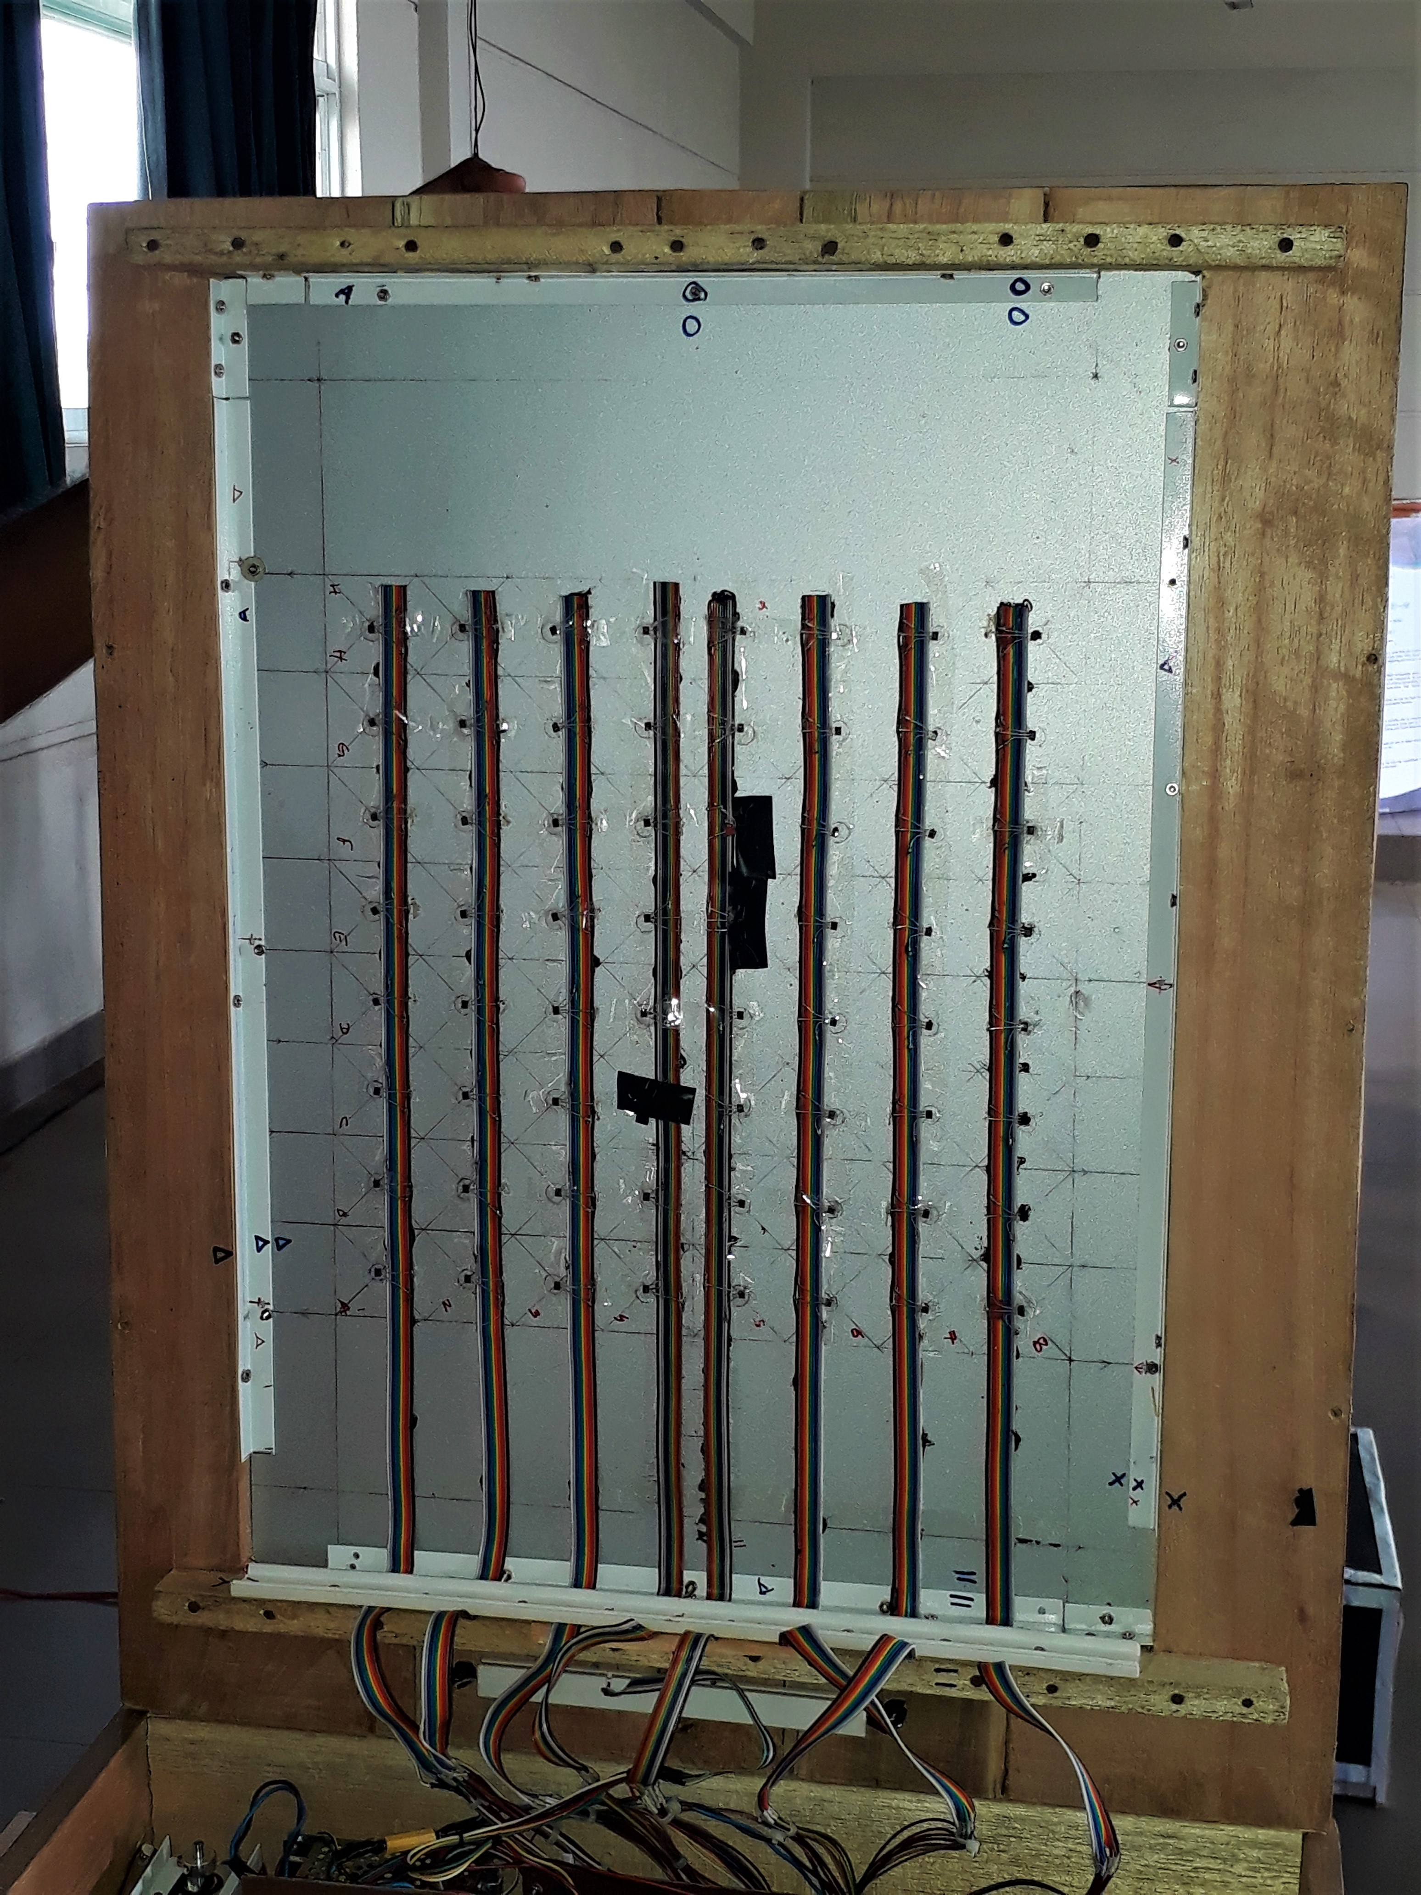
Internals

Slide 13
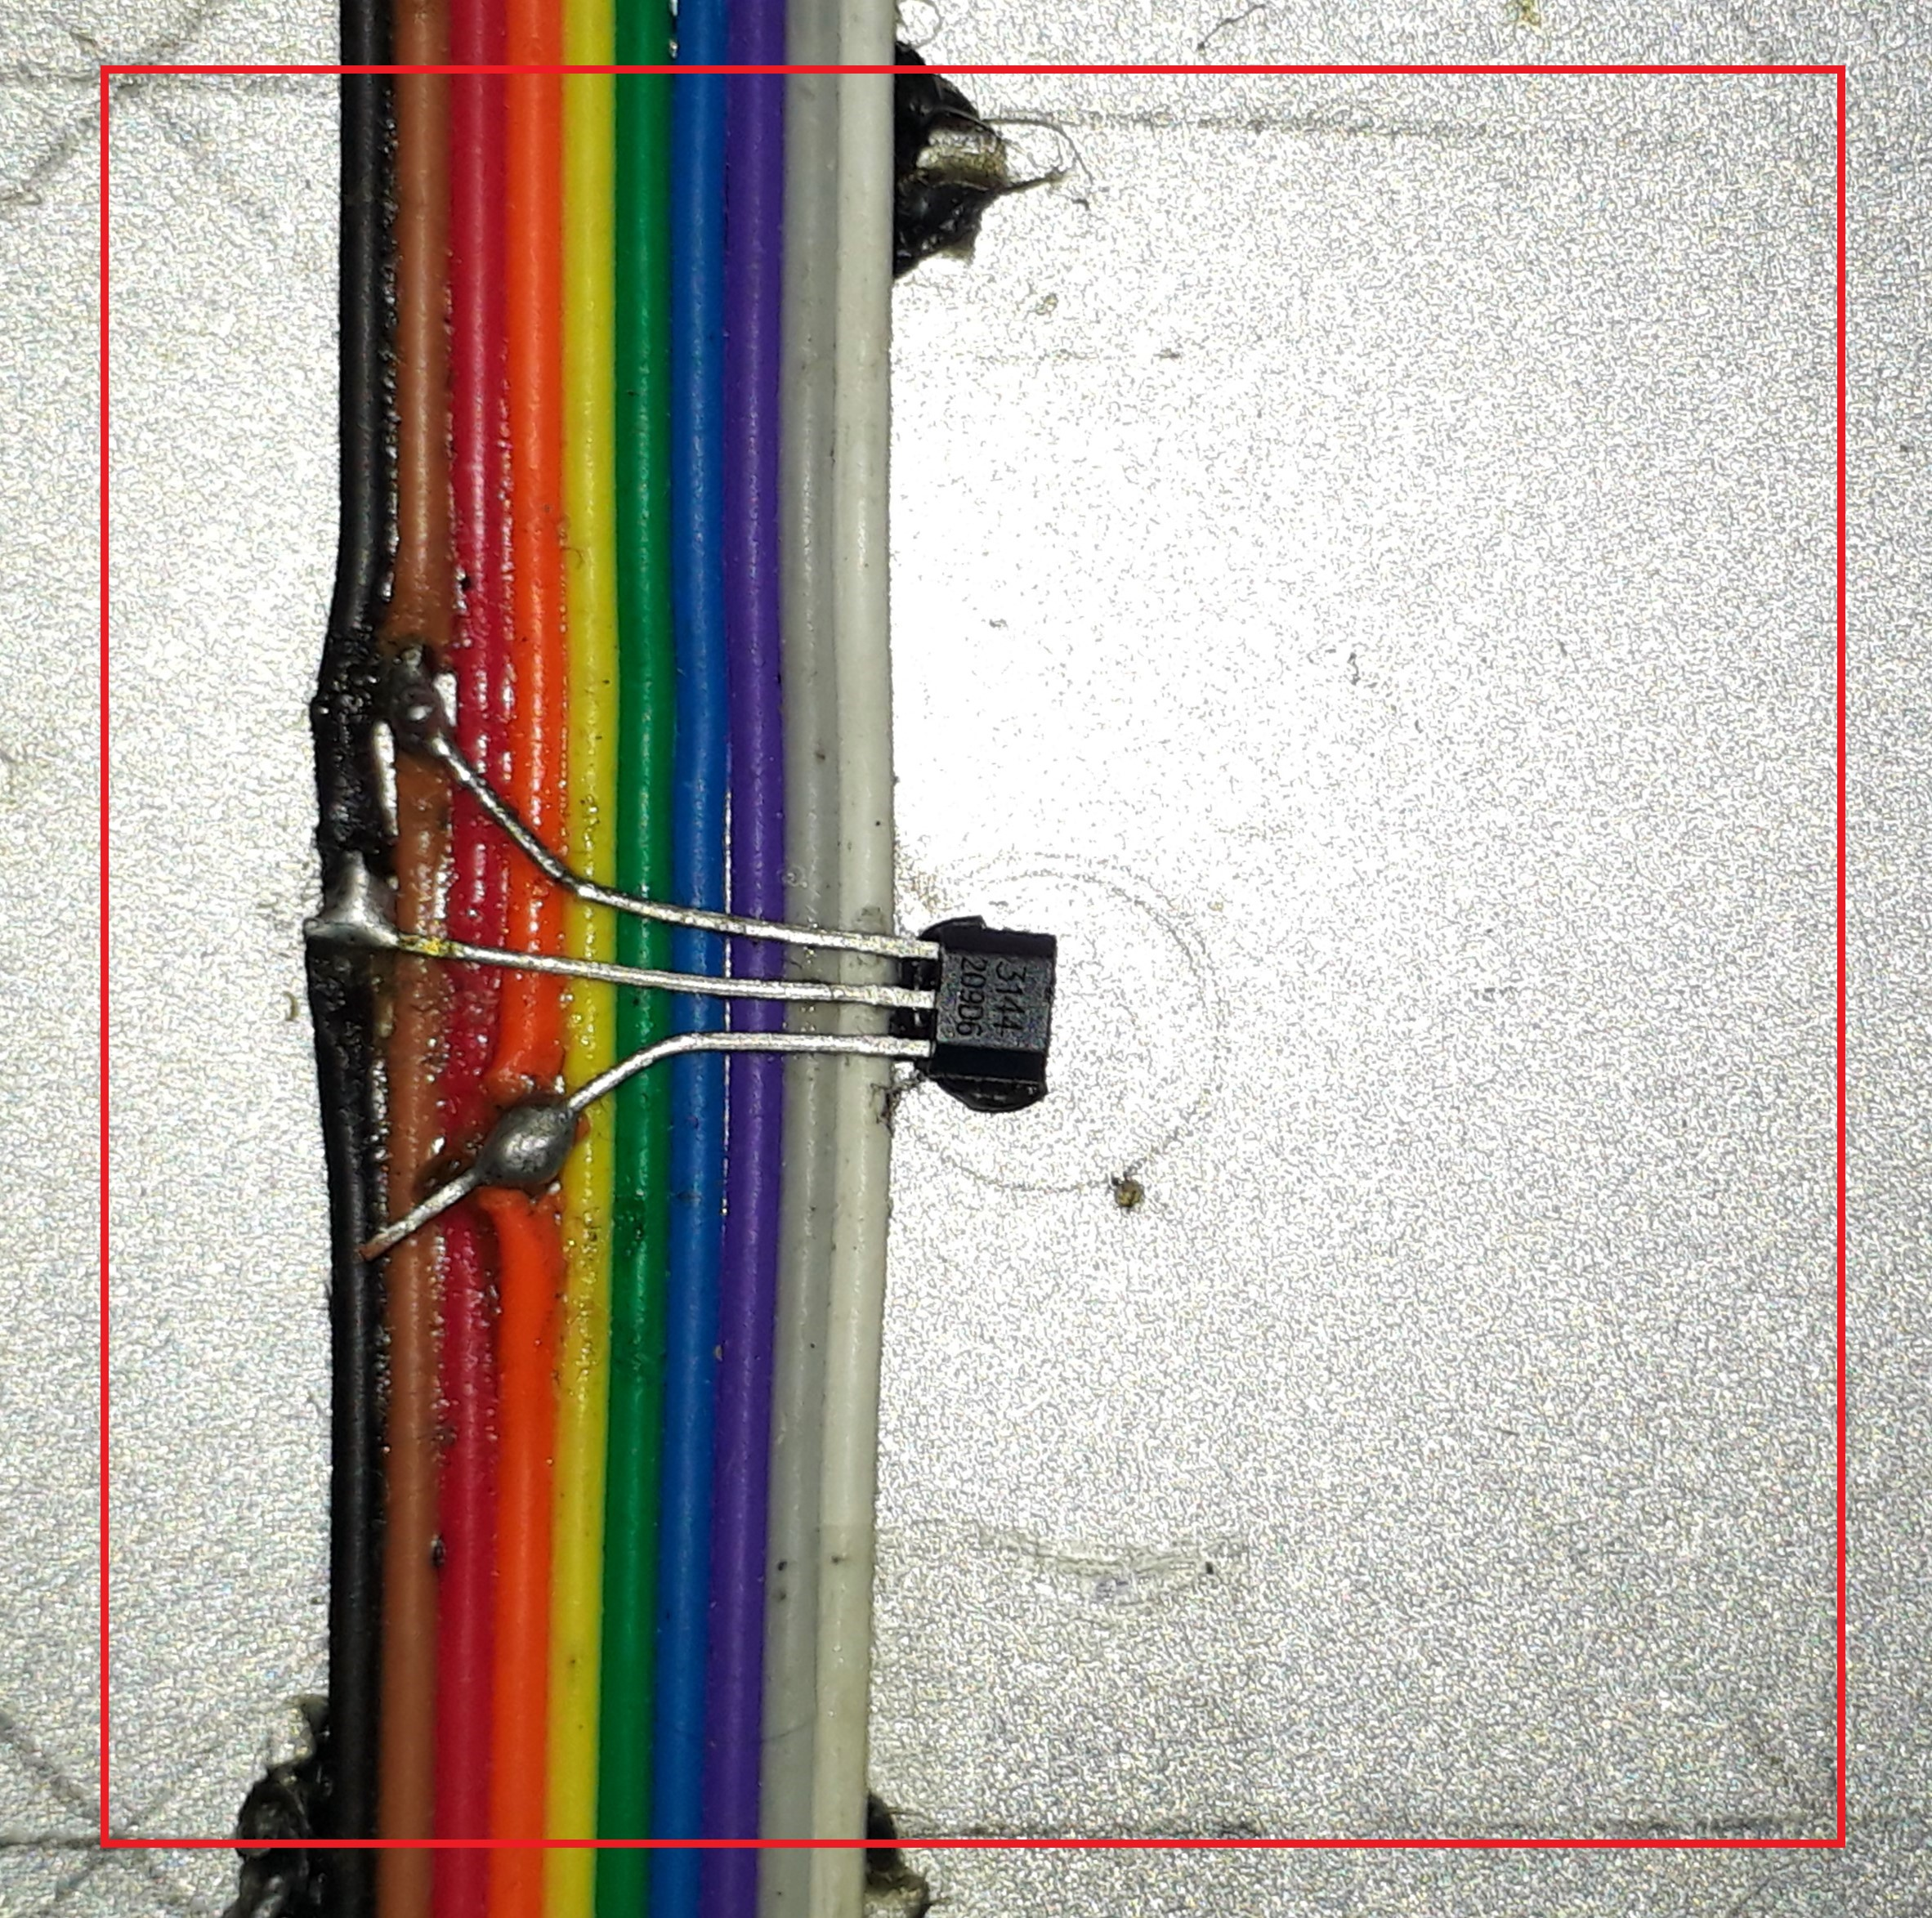
Internals

Slide 14
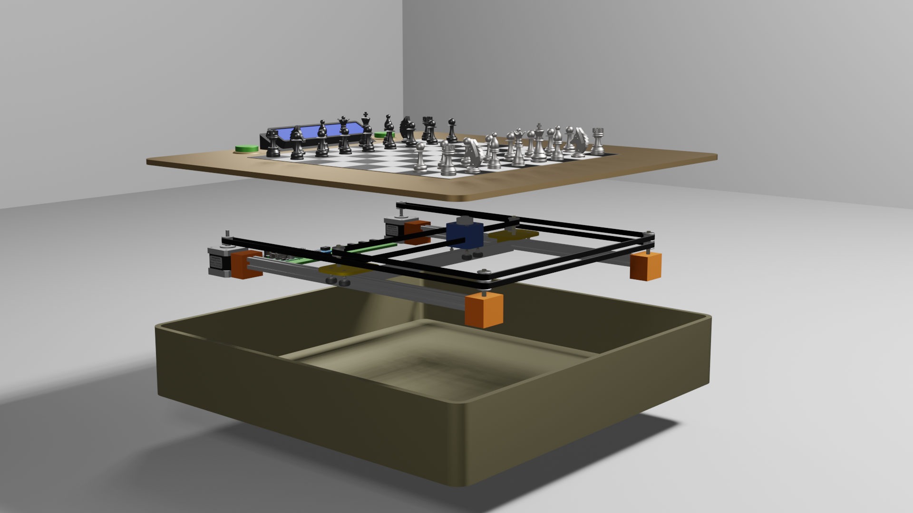
3D model - Exploded view

Slide 15
Mechanism
Hall effect sensors are used to track human movement.
The algorithm receives those moves and produces the resulting moves.
Motors will then operate in accordance with those movements, and the relevant pieces will be moved.

Slide 16

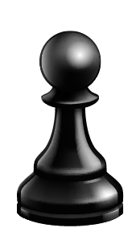
Chess Algorithm
An AI algorithm is used to make decisions about what will be the next best move.
For this project, the Micro Max chess program was used.
Creator - H.G. Muller
Arduino port - Diego Cueva

Slide 17
Advantages of Micro Max Chess Program
Smart
Efficient
Small (<2kB)
Open Source
This program is based on Minimax (MinMax) and Alpha-Beta Algorithms.

Slide 18
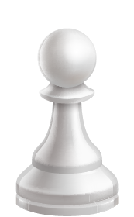
INdividuaL contribution

Slide 19
215565L - Weerasinghe RT
Hall Effect Sensors - A3144
Mux Modules - CD74HC4067
Voltage Regulator - XL4015

Slide 20
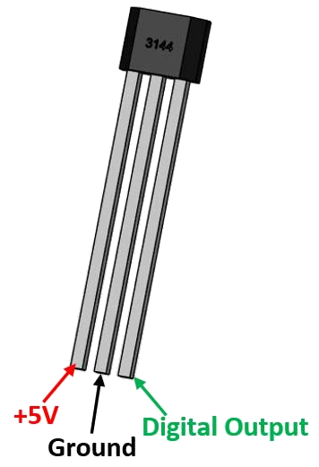
Hall effect Sensor - A3144
Hall effect sensors are used to detect chess pieces.
Each chess square has a A3144 sensor under it, thus a total of 64 such sensors were used
When a chess piece is there above a square, sensor according to that square outputs a “0” whereas if there isn’t a chess piece, corresponding sensor outputs a “1”. (was configured in that way)
Since the game always starts in a predefined board configuration, just by keeping a track of the changes we can determine which chess piece is where.

Slide 21
Hall effect Sensor - A3144
Specifications
Supply Voltage: 4.5V - 24V (absolute max 28V)
Supply Current: 4.4mA (Output off, at 8V supply voltage; max 9.0mA)
Small leakage current: 10µA max
Max. sink current: 25mA
Output rise time: 2µs max
Output fall time: 2µs max
Working temperature: -40℃ to +85℃

Slide 22
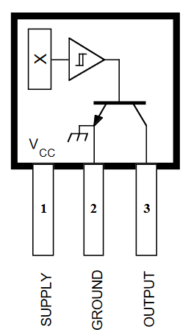
Hall effect Sensor - A3144
Technique
This sensor works on the hall effect principle. When a conductor carrying some current is introduced to a perpendicular magnetic field, a potential difference is created on the conductor which is perpendicular to the both current direction and magnetic field direction. Direction of this potential difference can be obtained by the “right hand rule”. This voltage is called the “Hall voltage” and the value of the this voltage is dependent on the strength of the magnetic field. This whole process involving the current carrying conductor and measuring the hall voltage is included in the part denoted “X” in the picture.

Slide 23
Hall effect Sensor - A3144
Technique (COntinued)
This measured Hall voltage is then amplified and fed into a Schmitt Trigger which adds a hysteresis effect to the output, keeping the output stable in the presence of mechanical vibration or environmental noise. Output of the Schmitt trigger is then passed on to a transistor. This transistor turns on in the presence of a correctly oriented magnetic field and connects the output to the ground, resulting in a “0” at the output. In other cases, transistor stays off putting the output in a “floating” state.

Slide 24
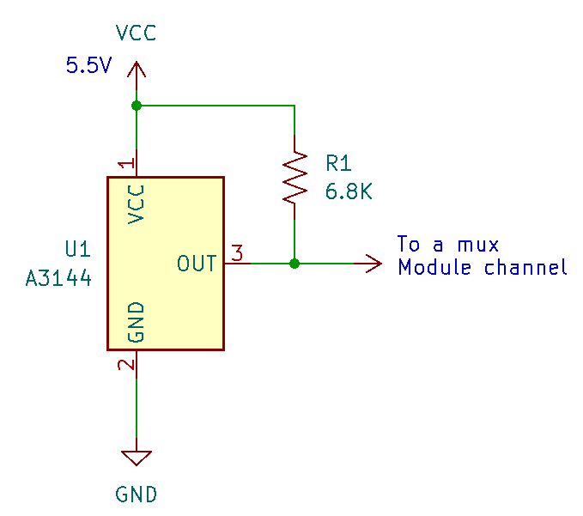
Hall effect Sensor - A3144
Technique (COntinued)
To get rid of this floating state, output of each sensor is pulled high to the supply voltage using a 6.8K resistor as follows.

Slide 25
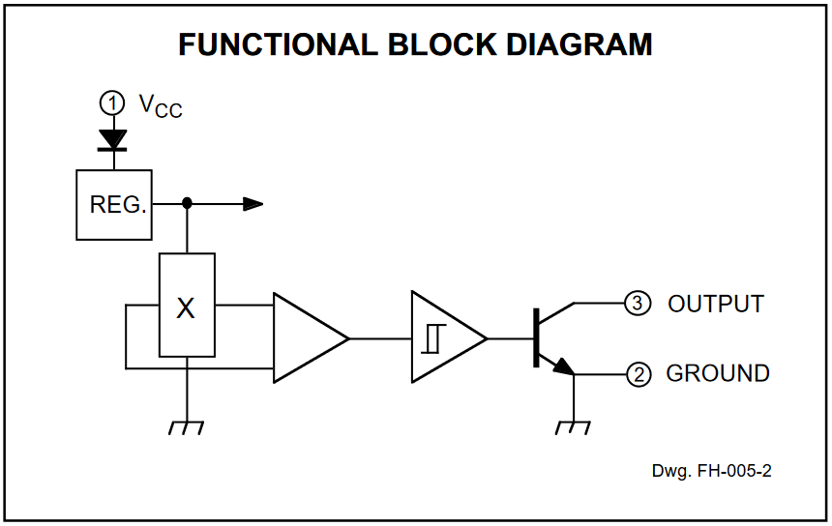
Hall effect Sensor - Full Block Diagram

Slide 26
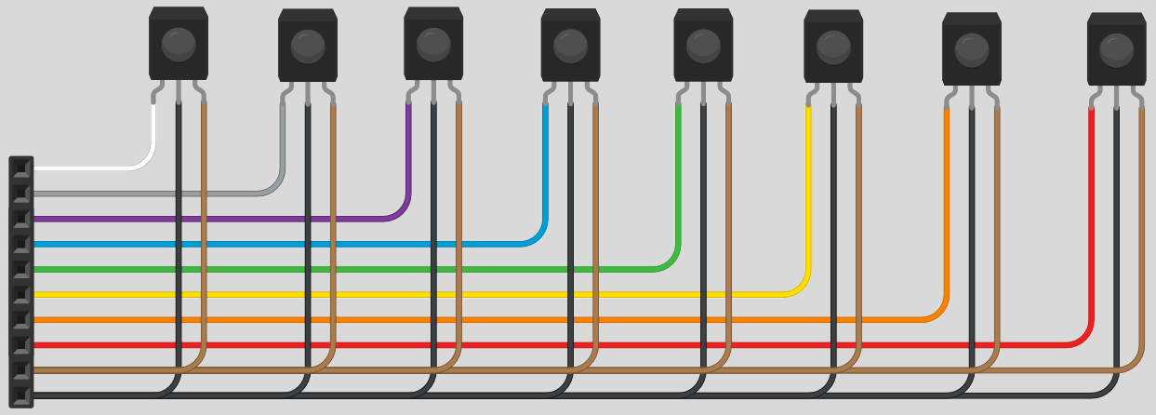
Hall effect Sensor - A3144
Arrangement of sensors
A total of 8 such sensor arrays were used
Power supplied to sensors through brown and black wires
Other wires are fed into mux module channel inputs

Slide 27
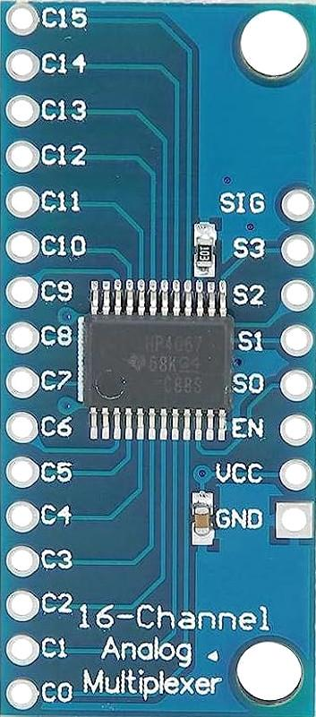
16-channel Mux module
CD74HC4067
Since arduino can’t accept 64 inputs from hall effect sensors, no of inputs should be reduced. This is done by using this CD74HC4067 mux modules.
Each module handles 16 sensor outputs (16 sensors) thus a total of 4 such modules are used.
Each hall effect sensor output is connected to each channel in mux module (channels range from C0 to C15)
Then a single channel (per module) is read at a time through the module’s sig pin.

Slide 28
16-channel Mux module
Specifications
Supply Voltage: 2V to 6V (absolute max 7V)
Switching: 6ns (at 4.5V)
High Speed CMOS technology
Source/sink current per pin: 25mA max
Temperature range: -55℃ to 125℃
Input rise and fall times: 500ns (max at 4.5V supply voltage)
Low leakage currents: <1µA per channel at 25℃

Slide 29
16-channel Mux module
Technique
Module must be activated by pulling EN pin to low. Then according to the channel you want to select, the correct binary sequence for that channel number must be provided to pins S0 to S3 where S0 being the LSB and S3 being the MSB.
After that, corresponding channel gets electrically connected with SIG pin in the module, allowing bi-directional transmission of data.

Slide 30
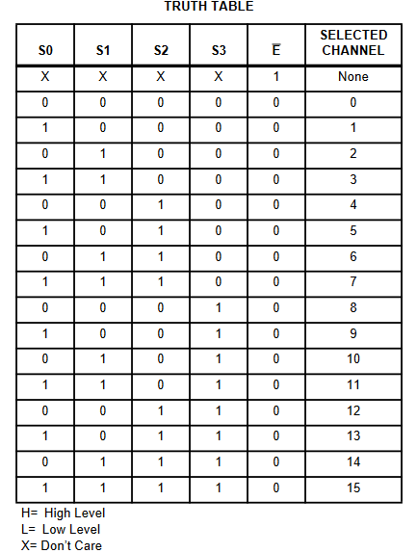
16-channel Mux module
Technique

Slide 31
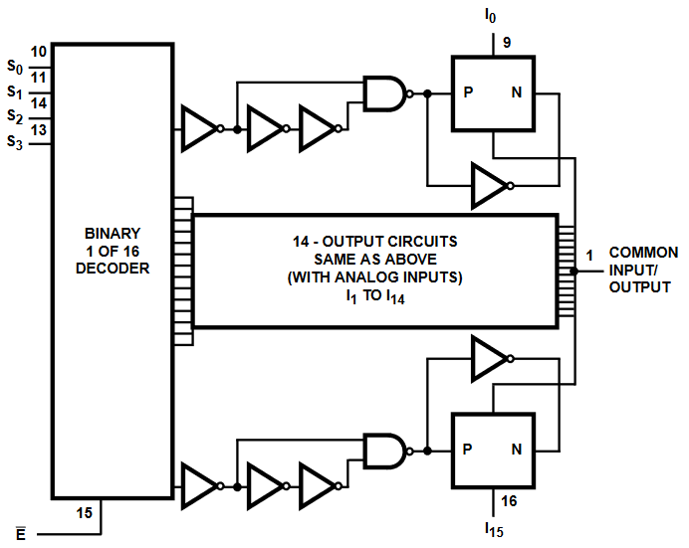
16-channel Mux module
Functional Block diagram

Slide 32
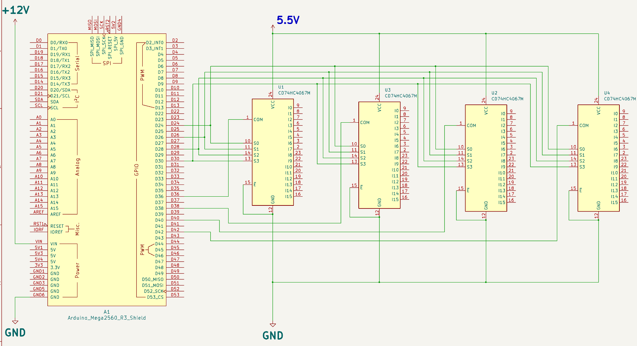
Mux circuit - part 1

Slide 33
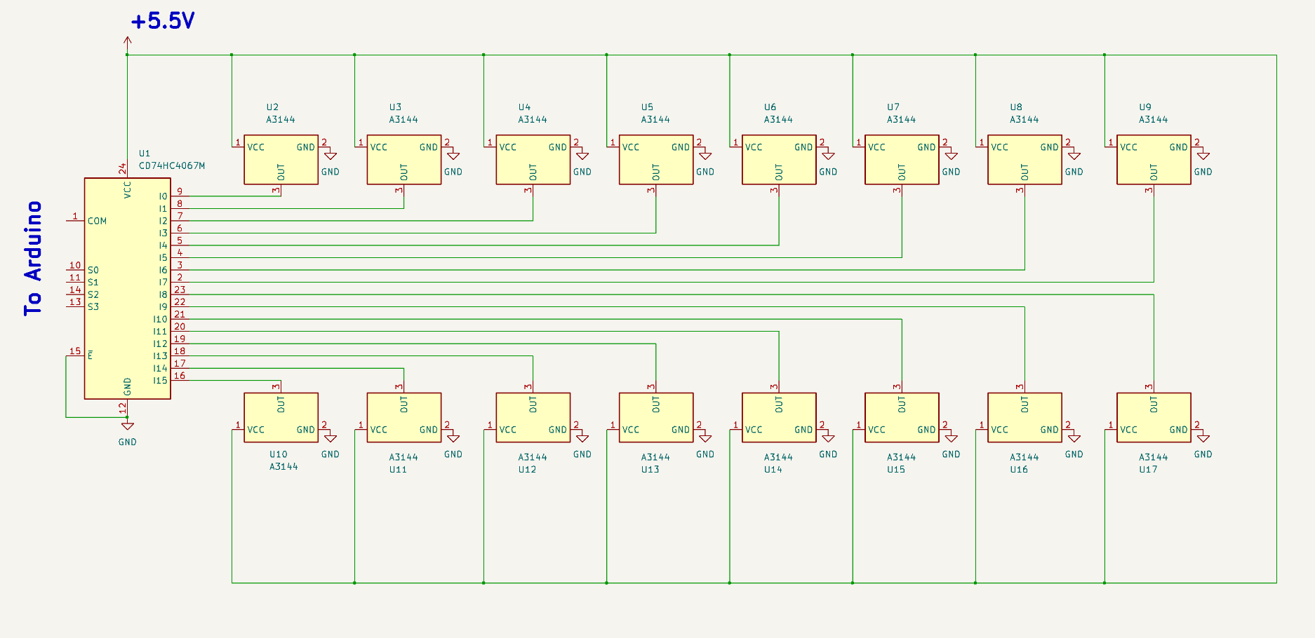
Mux circuit - part 2

Slide 34
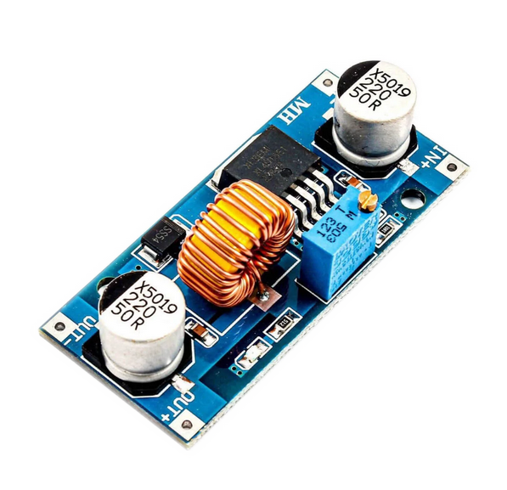
Voltage Regulator - XL4015
Used to convert the 12V supply to a 5.5V supply so that it can be safely supplied to the mux modules and hall effect sensors without damaging the mux modules.
It was observed that there is a 0.2V-0.3V typical voltage drop across the wires for the hall effect sensors.
Hall effect sensors need at least 4.5V to operate correctly, thus output of this regulator was adjusted to 5.5V so even in extreme cases, hall effect sensors would get more than 4.5V supply.

Slide 35
Voltage Regulator - XL4015
A single hall effect sensor requires ∼10mA of operating current and can sink upto 25mA when it is turned on.
Thus a sensor could require 35mA of current in extreme cases.
Considering this for all 64 sensors give us a current requirement of ∼2.2A.
This can be easily supplied with the chosen module. (maximum of 5A possible)

Slide 36
Voltage Regulator - XL4015
Specifications
Input Voltage: 8V - 36V
Output Voltage: 1.25V - 32V (adjustable)
High frequency PWM (180 kHz)
5A constant current output capability
Upto 96% efficiency
Built in short circuit protection
Built in thermal shutdown
Built in current limiter (7A)
Operating junction temperature: -40℃ to 125℃

Slide 37
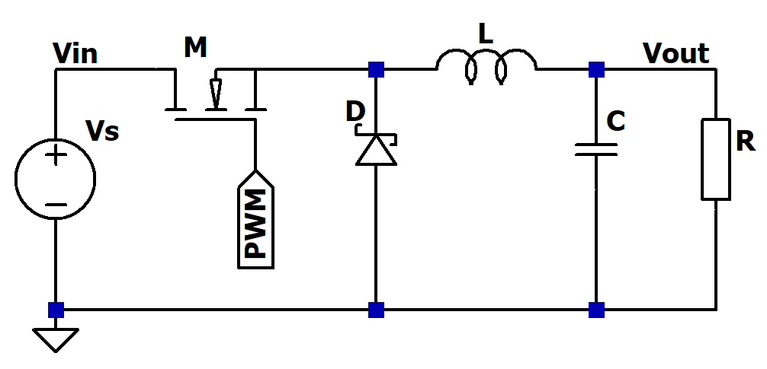
Voltage Regulator - XL4015
Technique
Module is based on XL4015 regulator IC.
IC works on a constant frequency PWM signal which is oscillating at 180 kHz. By adjusting the duty cycle of the PWM, a variable output voltage can be obtained.

Slide 38
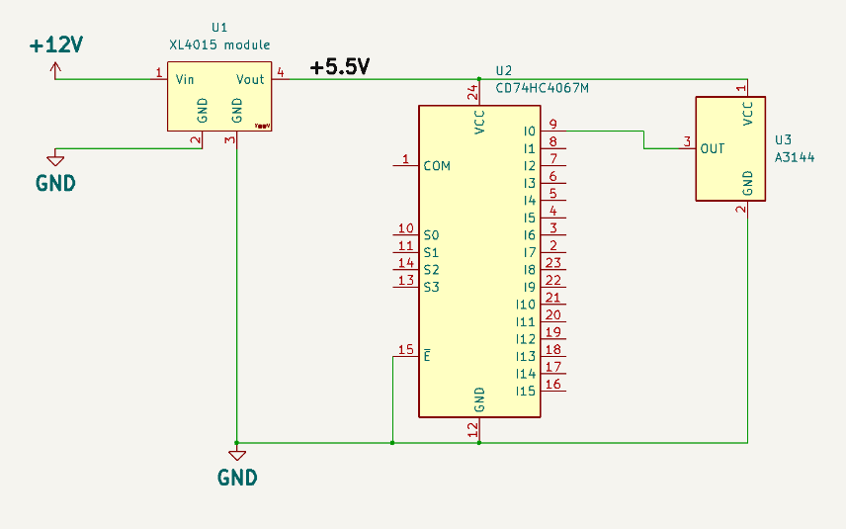
XL4015 - Circuit

Slide 39
215527A - Harischandra HBR
Stepper Motors - 17HS3430
Stepper Drivers - DRV8825
Limit Switches

Slide 40
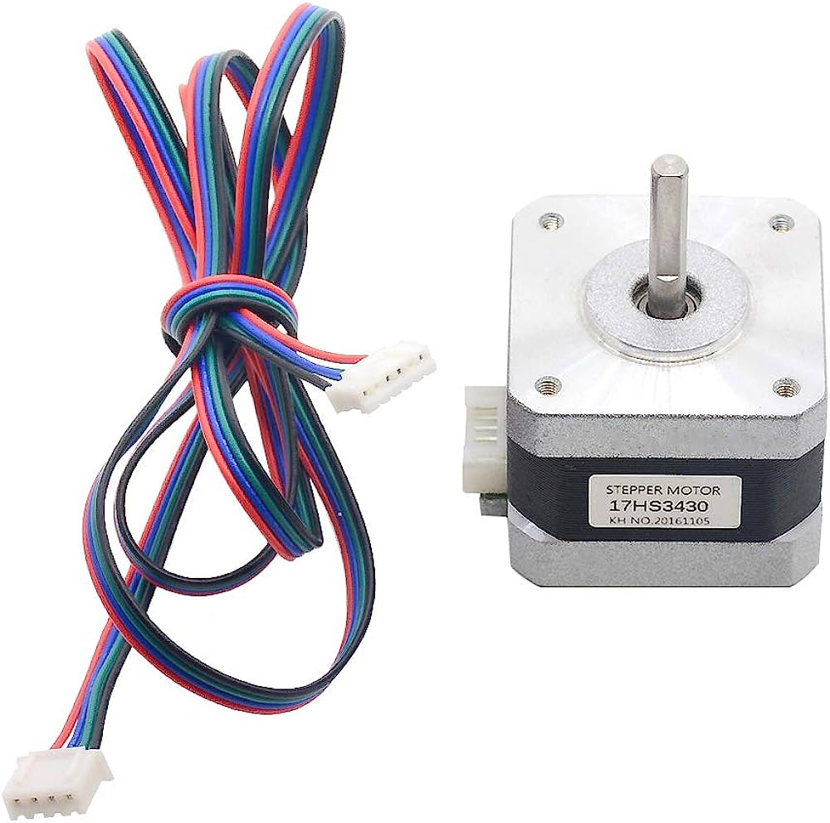
Stepper Motor x2 - 17HS3430 Hybrid
Rated Current - 0.4A
Phase Resistance - 30 ohm
Phase inductance - 35mH
Min Holding Torque - 28Ncm
Max Detent Torque - 1.6Ncm
Step angle - 1.8 deg

Slide 41
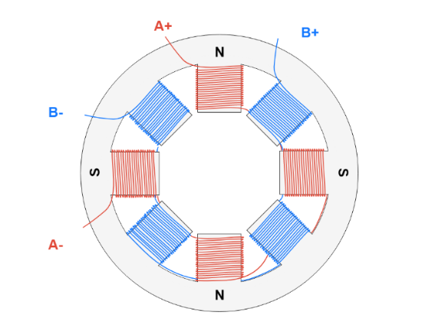
Internal Mechanism
The Stator of the motor:
This contains two independent coil sets.
When a one coil set is energized a magnetic field is generated giving north and south poles to different coil sets.
Coils in a coil set that are aligned gets the same polarity.

Slide 42
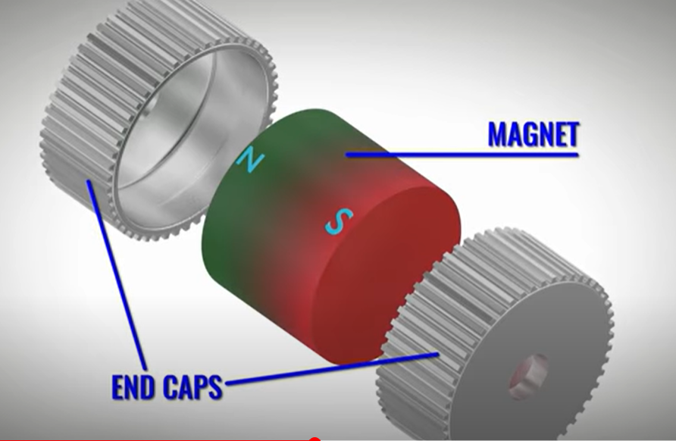
Internal Mechanism
The Rotor of the motor:
This contains two end caps and a magnet.
Each end cap has teeth and one end cap is polarized north and the other south.
This is called a hybrid motor.

Slide 43
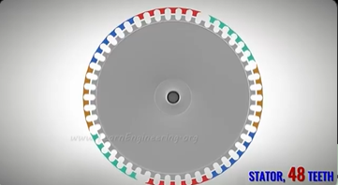
Internal Mechanism
The stator also have teeth.
But the stator have few less teeth than the rotor.
These teeth on the stator are arranged into four groups.

Slide 44
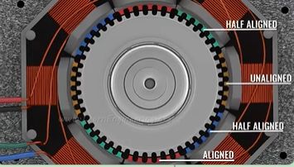
Internal Mechanism
The stator teeth groups are arranged in a way such that:
One group is aligned with the rotor teeth.
One group is not aligned with rotor teeth.
Two groups are half aligned with rotor . . teeth.

Slide 45
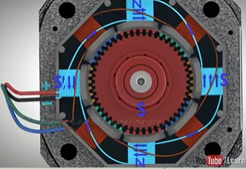
Internal Mechanism
When a one coil is energized the coils take a magnetized pattern as shown.
The north magnetized stator teeth are aligned with south magnetized rotor teeth.
Thus the rotor is kept in a holding position by the coil magnets.
(The same polarity poles are kept unaligned)

Slide 46
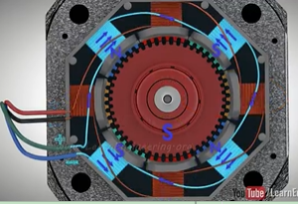
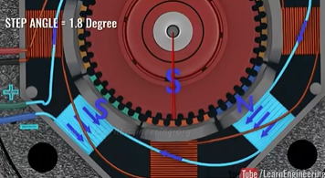
Internal Mechanism - rotation
When the other coil set is energized , due to the attraction of the opposite poles, the rotor will rotate 1.8 degrees.
And a previously half aligned stator teeth set will no be aligned with the rotor teeth.
In this manner, by energizing two coil sets one after another in opposite directions, the rotor will rotate by taking steps of 1.8 degrees.

Slide 47
Internal Mechanism - MicroStepping
By energizing both the coil sets in a way where both the adjacent stator teeth sets have the polarity to attract the rotor teeth then the rotor will only rotate a half of its original step.
By using a more advanced driver this can be taken further by adjusting the current intensity of the coil sets with high precision in order to reduce the step angle.
In this manner the step angle can be reduced upto 1/32 of the original step angle.

Slide 48
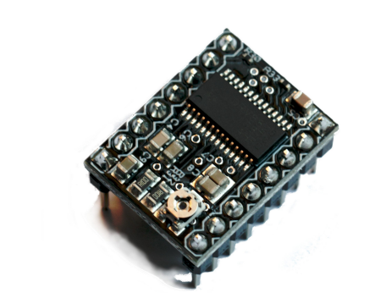
Stepper Motor Driver
Operating Voltage (logic) - 3 - 5.25V
Operating Voltage (Vmot) - 12 -24V
Max Current - 2.5A

Slide 49
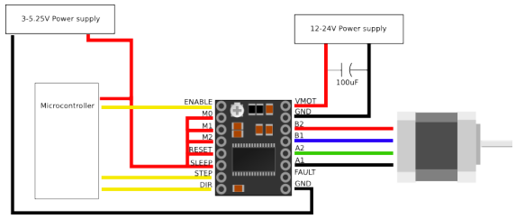
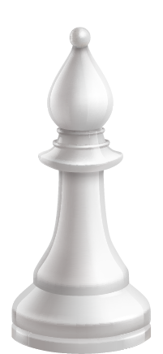
Driver connections
All the Micro Step Pins are given high in order to achieve 1/32 microstepping

Slide 50
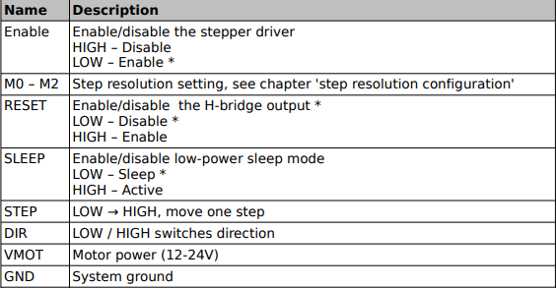

Slide 51
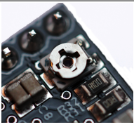
Adjusting the current provided to the motors
The relevant current required for each motor to work is adjusted by using the trimpot on the module.
By rotating it anti-clockwise -> the current drops
By rotating clockwise -> the current increases

Slide 52
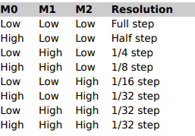
MicroStepping Configuration
The flexibility to achieve different microstepping configurations during the production and testing process was achieved
By installing DIP switches for the M0, M1 and M2 pins.
In the final product all the M0, M1 & M2 pins are set to high in order to achieve 1/32 MicroStepping.

Slide 53
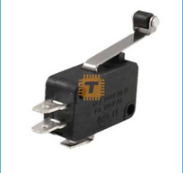
Micro Limit Switches
20 mm roller Lever
125/250 AC Voltage -> Max 0.6A current
125/250 DC Voltage -> Max 0.3A current

Slide 54
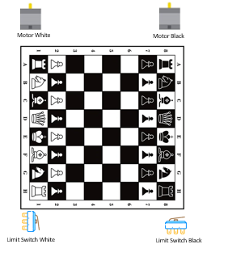
Limit Switches Positioning

Slide 55
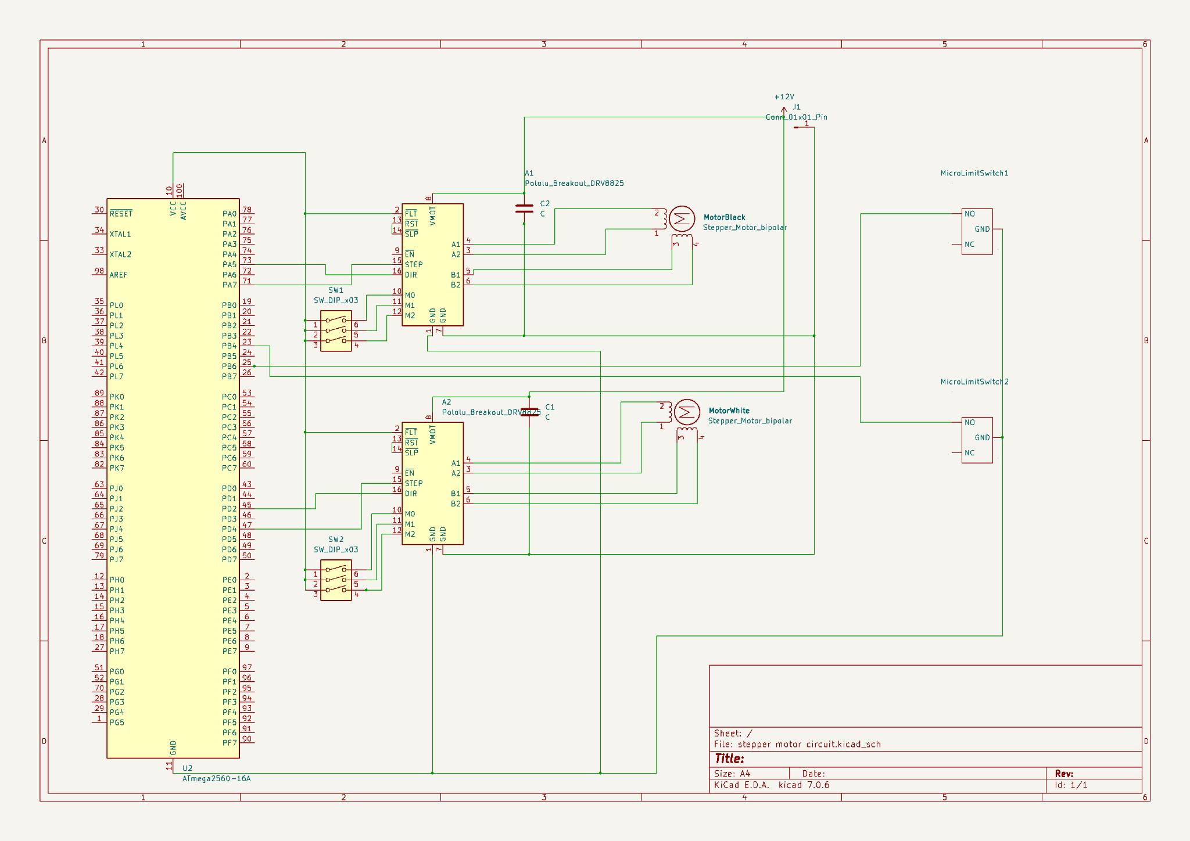
Schematic Diagram for
stepper motors & limit switches
1k resistor
1k resistor

Slide 56
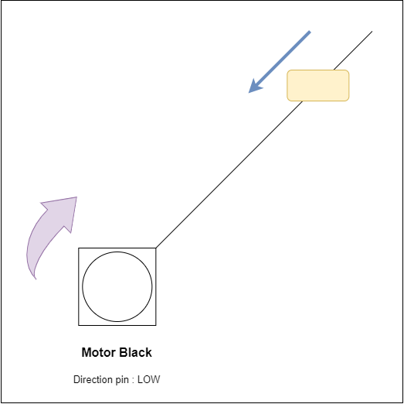
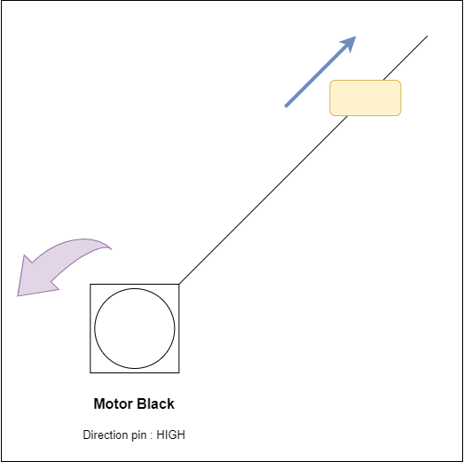
Motor mechanism

Slide 57
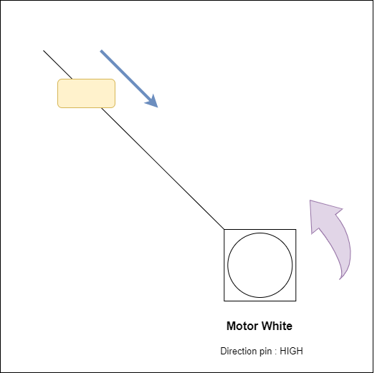
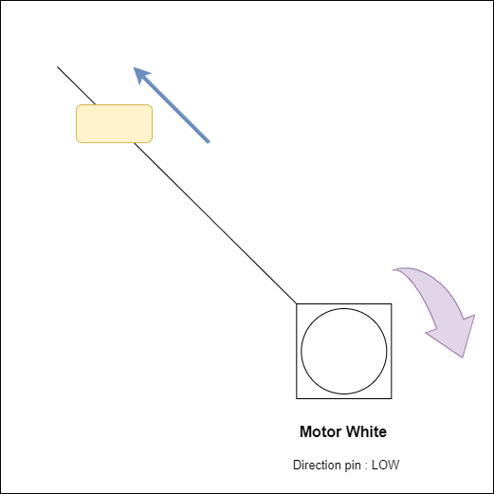
Motor mechanism

Slide 58
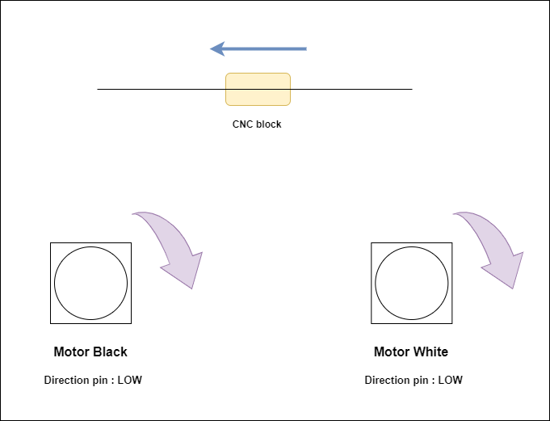
Motor mechanism

Slide 59
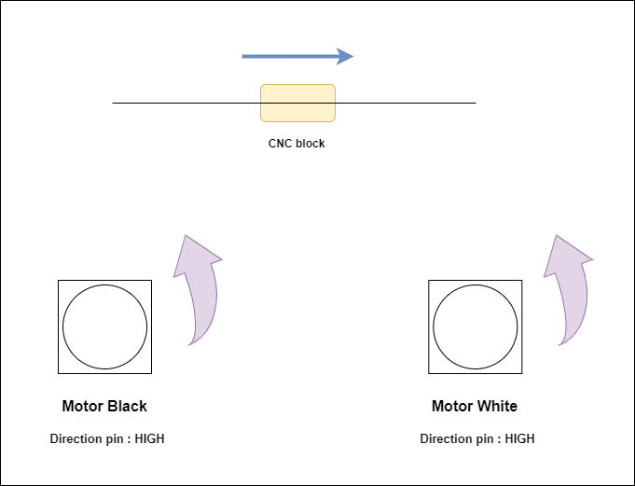
Motor mechanism

Slide 60
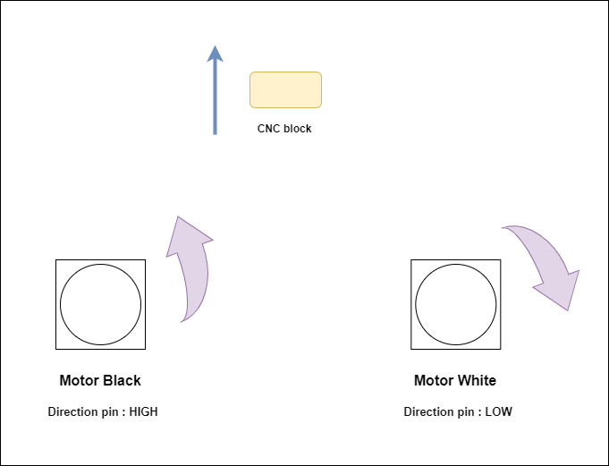
Motor mechanism

Slide 61
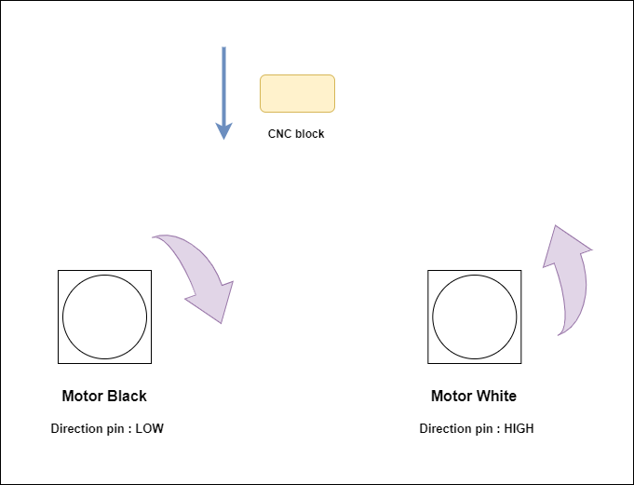
Motor mechanism

Slide 62

Motor Function Code

Slide 63

The Chess Board Coordinates System

Slide 64
Motor Calibration Function
WHY?
When a new game is started we have no idea about the current position of the trolley.
PROCEDURE
The calibration function is executed to find the correct coordinates of the trolley when a new game is started.
During the calibration process the trolley is taken near the (1,1) coordinates by taking inputs from the limit switches to determine the boundaries.
Then after that by giving hard coded instructions the trolley is taken to the middle of the (7,4) coordinates (the e7 square) and the trolley coordinates are updated as (7,4).

Slide 65

Calibration process

Slide 66
Calibration process
The trolley is slowly moved towards the “BLACK” limit switch until it touches it.
Then the trolley is slowly moved towards the “WHITE” limit switch until the trolley meets it.
Then by sending pre-defined sitances horizontally and vertically, the trolley is bought to the e7 square in a way such that the electromagnet is placed in the middle of the square.
Now the program has an accurate idea about the current position of the trolley.

Slide 67

Motor Calibration Function Code

Slide 68
Black player Displacement
There are two major parts in this function:
White Capturing - If the black player is capturing a white piece, removing the relevant white piece from the board is done in this section.
Black Chess Piece Movement - the movement of the relevant black piece from it’s departure position to the destination position is addressed in this section. Since the game of chess has different kinds of movements, our code address them in 6 separate ways.
Knight Movement
Diagonal Movement - diagonal moves of pawns, bishops & queen
Horizontal Movement - moving only across the x-axis
Vertical Movement - moving only across the y-axis
Kingside Castling
Queenside Castling

Slide 69

Black Player Movement function initial Code

Slide 70
In this part:
The coordinate system coming from the algorithm is converted to the coordinates used on the chess board trolley positions.
Departure Coordinates: the coordinates of the square which has the black piece that needs to be moved.
Arrival Coordinates: the coordinates of the square which the black need to be moved to

Slide 71
White Capturing
Check whether a white piece occupies the destination position of the current black movement.
If so, take that white piece out of the chess board and place it in a position that is reserved for the captured pieces.
Then come back to the current position of the relevant black piece and then move it to the place which the captured white piece was previously on.
If there are no white pieces present in the destination position of the current moving black piece then:
The trolley till go to the current position of the relevant black piece and then move it to the relevant destination which is instructed by the micromax algorithm.

Slide 72
Black Player Movement function
initial Code

Slide 73
Serial Communication
WHY?
The MicroMax Algorithm can’t run in the Arduino Mega for too long. That’s because the MicroMax Algorithm performs too many recursion functions and takes a lot of memory and computing power while performing these functions and thus the Mega board is not compatible of providing the required SRAM for a smooth performance.
NodeMCU 32-S
Therefore, we tackle this problem by running the MicroMax Algorithm in a separate Node MCU 32-S board. In this way we were able to achieve responses from the algorithm in a very short time period. Plus, the NodeMCUs higher SRAM capacity (64kB) allows the algorithm to perform it’s recursive functions as smooth as possible.

Slide 74

Serial Communication Circuit Diagram

Slide 75
From Mega to NodeMCU 32-S
The move done by the human player is sent to the node in the form of a size 4 array
During the RESTART game state a single letter is sent to the Node to trigger the ESP.restart() function in the NodeMCU 32-S.
From NodeMCU 32-S to Mega
The Node is sending either the reply move by the algorithm (in the form of a size 4 array) or sending messages identifying special states such as:
NO VALID MOVE - ”NV”
COMPUTER WINS - “CW”
PLAYER WINS - “PW”
Invalid Move Punishment - “IP”

Slide 76
215538H - Naranpanawa HMSDK
Electromagnet and Transistor
L7805 Voltage Regulator
Power Supply Unit

Slide 77

Electromagnet - P25/20
Electromagnet is used to move the chess pieces because it can generate a magnetic field which creates the link between the it and the chess pieces.
The electromagnet is placed underneath the chessboard, and it would move the pieces with great accuracy and precision.

Slide 78

An electromagnet is a solenoid wrapped around a bar of iron or other ferromagnetic material.
The magnetic field of the solenoid magnetizes the iron bar by aligning its magnetic domains.
The main advantage of an electromagnet over a permanent magnet is that it can produce a magnetic field when needed.
The electromagnet creates a magnetic field only if an electric current run through it, if the electric current is turned off the magnetic field stops.

Slide 79

Specifications -:
Nominal Voltage: 5V DC
Current Draw: 0.3 Amps at 5V
Holding Force: 5 Kg
Diameter: 25mm
Center Diameter: 12mm
Height: 20mm
Lead Length: 280mm

Slide 80
Technique -:
The chessboard is equipped with a single electromagnet positioned on a movable platform.
The electromagnet is connected to a system of motors and belts.
Each chess piece has a magnetic base for attraction.
When a move needs to be made, the motors are activated, causing the movable platform to move along the belts.
The electromagnet, mounted on the movable platform, is positioned below the chess piece that needs to be moved.

Slide 81
When algorithm decided the move, the electromagnet is activated, creating a magnetic field that attracts the magnetic base of the chess piece.
The movable platform, carrying the electromagnet and the attracted chess piece, moves along the belts to the desired destination square that provided by the algorithm.
Once the movable platform reaches the destination square, the electromagnet is deactivated, releasing the chess piece.
The motors then move the movable platform back to its starting position or to prepare for the next move.
The chessboard is now ready for the next move, and the process repeats as needed.

Slide 82

Transistor - TIP120 NPN
Due to insufficient power delivery, the Arduino's output pins are unable to directly power the electromagnet.
Therefore, an independent electric current must be linked to the electromagnet.
When necessary, an electromagnet is powered by an Arduino-controlled power transistor component that serves as a switch.
The benefit of the power transistor is that it can be controlled by the Arduino because only a little amount of amperage is required.

Slide 83

Specifications -:
Type: NPN Power Darlington transistor
Package: TO-220
Collector-Base voltage: 60 V
Collector-Emitter voltage: 60 V
Emitter-Base voltage: 5 V
Peak-load current(IC): 8 A
Continuous load current(IC): 5 A
Junction Temperature range: -65 to +150 °C

Slide 84
Technique -:
The TIP120 transistor is a Darlington pair transistor, which means that it is actually two transistors connected together in a special way.
This transistor has a very high current gain, which means that a small current applied to the base can control a much larger current flowing through the collector and emitter.
The TIP120 transistor is a NPN transistor, which means that the current flows from the emitter to the collector when the base is turned on.
The base-emitter junction of a TIP20 transistor has a very low forward voltage drop, typically around 0.7 volts.
This means that a very small current, on the order of milliamps, is enough to turn on the transistor and allow a much larger current to flow through the collector and emitter.

Slide 85


Voltage Regulator - L7805CV
The L7805CV is a three-terminal linear voltage regulator that produces a fixed output voltage of 5 volts.

Slide 86
Specifications -:
Output: +5V, up to 1.5A with peak current of 2.2A
Current Output: up to 1.5A with peak current of 2.2A
Input Voltage: 7V Minimum, 25V Maximum
Package: TO-220
Pin Spacing Pitch: 2.54mm (0.1in)
Hole Diameter: 3.8mm (0.15in)
Operating temperature range: 0°C to 125°C

Slide 87
Technique -:
L7805CV regulator works by using a transistor to control the current flow through a resistor.
The input voltage is applied to the input terminal of the regulator.
The transistor in the regulator turns on and allows current to flow through the resistor.
The resistor is connected between the input and output terminals of the regulator.
When the input voltage is higher than the output voltage, the transistor will allow current to flow through the resistor, which will drop the voltage to the desired output level.
The output voltage is available at the output terminal of the regulator.

Slide 88

Schematic Diagram of Electromagnet

Slide 89

Power Supply Unit - PS0052
A 12V 5A SMPS (Switched-Mode Power Supply) power supply is a type of power supply that uses a switching regulator to convert AC input voltage to DC output voltage.
The metal casing helps to protect the SMPS from damage and also helps to dissipate heat.
It can typically convert more than 80% of the input power into output power.

Slide 90

Specifications -:
Input Voltage Range: 110-240VAC
Input Frequency Range: 50 to 60 Hz
Output Voltage Range: 12VDC
Output Current: 5A
DC Output Power: 60W
Shell Material: Metal case / Aluminum case
Color: Silver Color
Heat Dissipation Method: Passive Cooling

Slide 91
Technique -:
The AC input voltage is rectified to DC voltage using a diode bridge.
This converts the AC voltage to a pulsating DC voltage.
The pulsating DC voltage is then chopped into a high-frequency square wave using a switching transistor.
The switching transistor is turned on and off at a high frequency, which creates the square wave.
The square wave is then passed through a filter to produce a smooth DC output voltage.
The filter, is typically a combination of inductors and capacitors, removes the high-frequency components of the square wave, leaving a clean DC output voltage.

Slide 92
215559X - Shamil MRM
LCD
I2C Module
Push Buttons

Slide 93

Lcd display
The autonomous chess board features a state-of-the-art chess clock integrated into the LCD display.
The chess clock provides precise time tracking, enhancing the competitive nature of the game.
The LCD display offers real-time updates, keeping players informed about the progress of the game.
The comprehensive menu, accessible through the LCD display, provides a user-friendly interface.

Slide 94
specifications:
Display type : Alphanumeric LCD
Display size : 16 characters per line,2 lines
Character size : 5*8 dots
Supply voltage : 5V
Backlight : white text in blue background
Controller : Hitachi HD4478
Contrast control : can adjust the contrast using a potentiometer

Slide 95

I2c module
Importance of I2C module in LCD Display
Reduced pin usage
Simplified wiring
Compatibility
Addressable communication
Software efficiency

Slide 96

I2C module offers 4 pin functionality instead of 16 pins.
VCC : Power supply
GND: ground pin
SDA : serial data pin
SCL : serial clock pin
PCF8574 expander chip converts I2C data from arduino into parallel LCD display
We can control the contrast by adjusting the potentiometer.
A jumper on board powers backlight; external voltage applied to LED header pin for intensity control.
Address selectors enable flexible system design, connecting multiple devices to I2C bus.

Slide 97
Budget
Item | Unit Price (Rs.) | Qty | Amount (Rs.)
Arduino Mega NodeMCU 32-S IN4001 diode Micro limit switch Magnet button cell 8x2 Push on switch 10-core wire ribbon 12-core wire ribbon 17HS3430 NEMA 17 stepper CD74HC4067 Mux module 12V 5A Power supply 6.8K SMD resistors (pack of 40) XL4015 Buck converter | 5800.00 1650.00 2.00 55.00 25.00 30.00 150.00 175.00 2070.00 600.00 1500.00 80.00 450.00 | 1 1 3 2 36 2 2 2 2 4 1 1 1 | 5800.00 1650.00 6.00 110.00 900.00 60.00 300.00 350.00 4 140.00 2400.00 1500.00 80.00 450.00

Slide 98
GT2 Belt GT2 5x20 pulley 3 slider DIP switch Electromagnet 5kg 5V L7805CV 5V Voltage Regulator GT2 4mm pulley (teethless) DRV8825 Stepper driver Chessboard pieces 3144 Hall effect sensors Railings and sliders Enclosure box Top surface plate 1602 LCD with I2C Miscellaneous (Bolts, Solder wire etc) Chessboard sticker Wood sticker | 350.00 220.00 40.00 1200.00 50.00 400.00 800.00 1840.00 40.00 4000.00 2000.00 1000.00 - 1000.00 700.00 500.00 | 5 2 2 1 2 8 2 1 70 1 1 1 1 1 1 1 | 1 750.00 440.00 80.00 1200.00 100.00 3 200.00 1 600.00 1 840.00 2 800.00 4 500.00 2 000.00 1 000.00 (Had in hand) 1 000.00 700.00 500.00
Total |  |  | 40 456.00

Slide 99
Q & A

Slide 100



Thank You!

